Slide 1
Modular arithmetic is working with remainders after dividing by the modulus
INSERT
VIDEO
HERE

Slide 2
Modular arithmetic is working with remainders after dividing by the modulus
Defining relationship for modular arithmetic
INSERT
VIDEO
HERE

Slide 3
Modular arithmetic is working with remainders after dividing by the modulus
Defining relationship for modular arithmetic
Residue/congruence classes
INSERT
VIDEO
HERE

Slide 4
Modular arithmetic is working with remainders after dividing by the modulus
Defining relationship for modular arithmetic
Residue/congruence classes
Modular congruence vs. modular reduction
INSERT
VIDEO
HERE

Slide 5
Modular arithmetic is working with remainders after dividing by the modulus
Defining relationship for modular arithmetic
Residue/congruence classes
Modular congruence vs. modular reduction
Modular operations
INSERT
VIDEO
HERE

Slide 6
Modular arithmetic is working with remainders after dividing by the modulus
Defining relationship for modular arithmetic
Residue/congruence classes
Modular congruence vs. modular reduction
Modular operations
When we can and can’t perform reductions
INSERT
VIDEO
HERE

Slide 7
Modular arithmetic is working with remainders after dividing by the modulus
Defining relationship for modular arithmetic
Residue/congruence classes
Modular congruence vs. modular reduction
Modular operations
When we can and can’t perform reductions
Divisibility rule examples
INSERT
VIDEO
HERE

Slide 8
Basic concepts of modular arithmetic are the same ones we learned in grade school
INSERT
VIDEO
HERE

Slide 9
Basic concepts of modular arithmetic are the same ones we learned in grade school
$n=q∙d+r$
INSERT
VIDEO
HERE

Slide 10
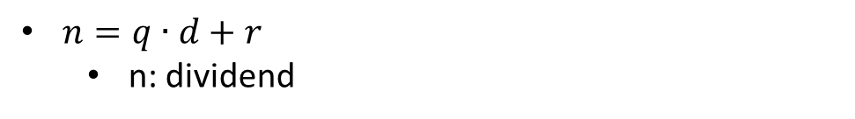
Basic concepts of modular arithmetic are the same ones we learned in grade school
$n=q∙d+r$
n: dividend
INSERT
VIDEO
HERE

Slide 11
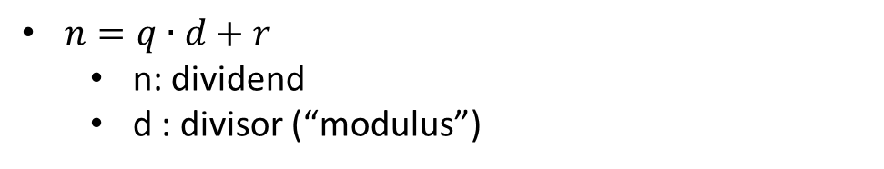
Basic concepts of modular arithmetic are the same ones we learned in grade school
$n=q∙d+r$
n: dividend
d : divisor (“modulus”)
INSERT
VIDEO
HERE

Slide 12
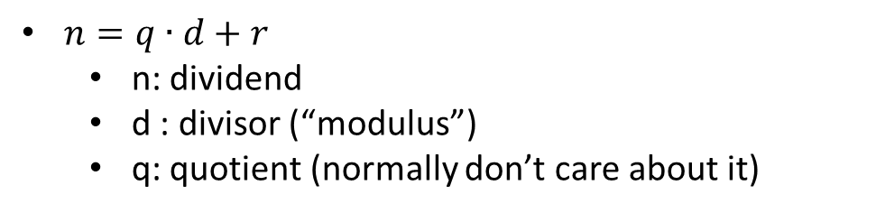
Basic concepts of modular arithmetic are the same ones we learned in grade school
$n=q∙d+r$
n: dividend
d : divisor (“modulus”)
q: quotient (normally don’t care about it)
INSERT
VIDEO
HERE

Slide 13
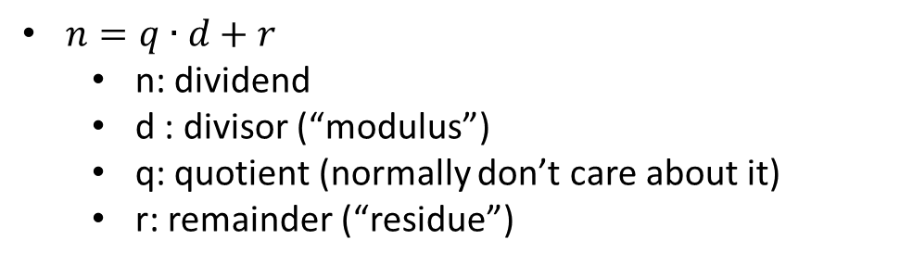
Basic concepts of modular arithmetic are the same ones we learned in grade school
$n=q∙d+r$
n: dividend
d : divisor (“modulus”)
q: quotient (normally don’t care about it)
r: remainder (“residue”)
INSERT
VIDEO
HERE

Slide 14
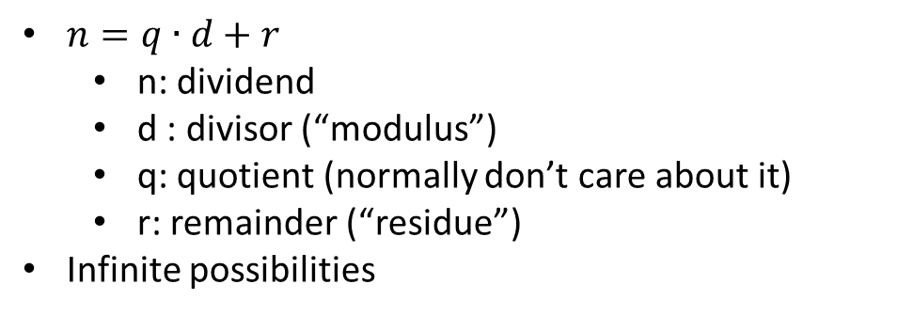
Basic concepts of modular arithmetic are the same ones we learned in grade school
$n=q∙d+r$
n: dividend
d : divisor (“modulus”)
q: quotient (normally don’t care about it)
r: remainder (“residue”)
Infinite possibilities
INSERT
VIDEO
HERE

Slide 15
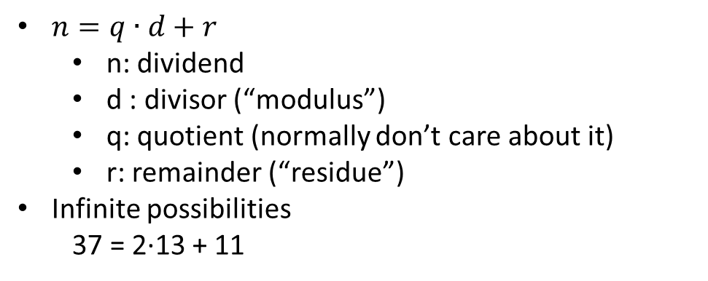
Basic concepts of modular arithmetic are the same ones we learned in grade school
$n=q∙d+r$
n: dividend
d : divisor (“modulus”)
q: quotient (normally don’t care about it)
r: remainder (“residue”)
Infinite possibilities
37 = 2·13 + 11
INSERT
VIDEO
HERE

Slide 16
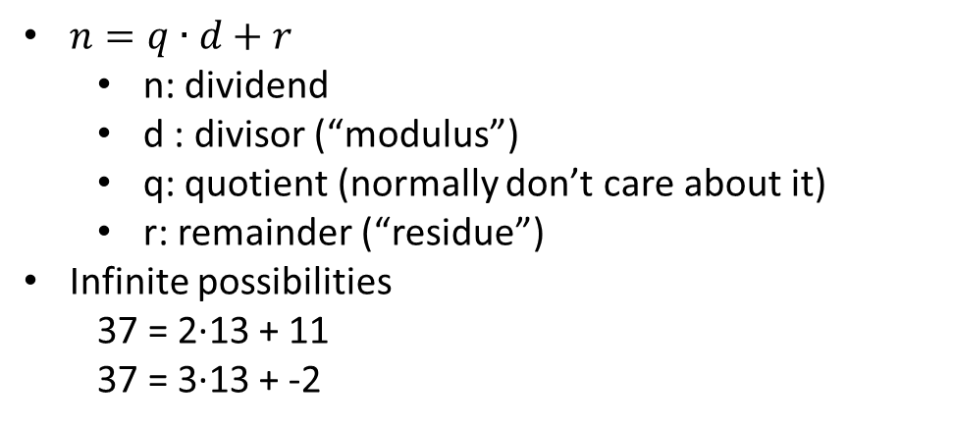
Basic concepts of modular arithmetic are the same ones we learned in grade school
$n=q∙d+r$
n: dividend
d : divisor (“modulus”)
q: quotient (normally don’t care about it)
r: remainder (“residue”)
Infinite possibilities
37 = 2·13 + 11
37 = 3·13 + -2
INSERT
VIDEO
HERE

Slide 17
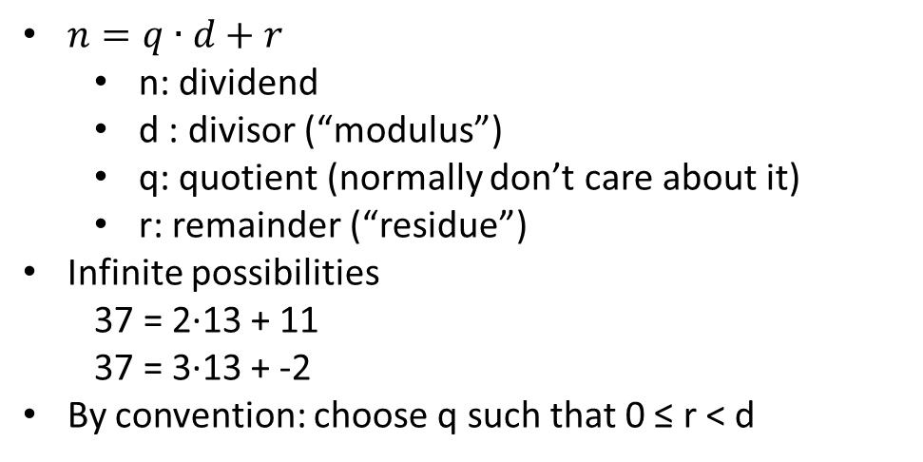
Basic concepts of modular arithmetic are the same ones we learned in grade school
$n=q∙d+r$
n: dividend
d : divisor (“modulus”)
q: quotient (normally don’t care about it)
r: remainder (“residue”)
Infinite possibilities
37 = 2·13 + 11
37 = 3·13 + -2
By convention: choose q such that 0 ≤ r < d
INSERT
VIDEO
HERE

Slide 18
Residue classes are sets of integers that are equivalent in a modular world
INSERT
VIDEO
HERE

Slide 19
Residue classes are sets of integers that are equivalent in a modular world
Integers partitioned into residue classes
INSERT
VIDEO
HERE

Slide 20
Residue classes are sets of integers that are equivalent in a modular world
Integers partitioned into residue classes
Number of residue classes equal to modulus
INSERT
VIDEO
HERE

Slide 21
Residue classes are sets of integers that are equivalent in a modular world
Integers partitioned into residue classes
Number of residue classes equal to modulus
Members of residue class congruent to each other
INSERT
VIDEO
HERE

Slide 22
Residue classes are sets of integers that are equivalent in a modular world
Integers partitioned into residue classes
Number of residue classes equal to modulus
Members of residue class congruent to each other
-2, 11, 24 are congruent modulo 13
INSERT
VIDEO
HERE

Slide 23
Residue classes are sets of integers that are equivalent in a modular world
Integers partitioned into residue classes
Number of residue classes equal to modulus
Members of residue class congruent to each other
-2, 11, 24 are congruent modulo 13
11 and 24 are not equal, but are congruent
INSERT
VIDEO
HERE

Slide 24
Residue classes are sets of integers that are equivalent in a modular world
Integers partitioned into residue classes
Number of residue classes equal to modulus
Members of residue class congruent to each other
-2, 11, 24 are congruent modulo 13
11 and 24 are not equal, but are congruent
Each residue class has a “class representative”
INSERT
VIDEO
HERE

Slide 25
Residue classes are sets of integers that are equivalent in a modular world
Integers partitioned into residue classes
Number of residue classes equal to modulus
Members of residue class congruent to each other
-2, 11, 24 are congruent modulo 13
11 and 24 are not equal, but are congruent
Each residue class has a “class representative”
Could pick representatives randomly
INSERT
VIDEO
HERE

Slide 26
Residue classes are sets of integers that are equivalent in a modular world
Integers partitioned into residue classes
Number of residue classes equal to modulus
Members of residue class congruent to each other
-2, 11, 24 are congruent modulo 13
11 and 24 are not equal, but are congruent
Each residue class has a “class representative”
Could pick representatives randomly
Least residue system: 0 ≤ r < modulus
INSERT
VIDEO
HERE

Slide 27
Two integers are congruent mod-N if their difference is divisible by N
INSERT
VIDEO
HERE

Slide 28
Two integers are congruent mod-N if their difference is divisible by N
a = kN + r, b = jN + r
INSERT
VIDEO
HERE

Slide 29
Two integers are congruent mod-N if their difference is divisible by N
a = kN + r, b = jN + r
(a-b) = (k-j)N
INSERT
VIDEO
HERE

Slide 30
Two integers are congruent mod-N if their difference is divisible by N
a = kN + r, b = jN + r
(a-b) = (k-j)N
a ≡ b (mod N)
INSERT
VIDEO
HERE

Slide 31
Two integers are congruent mod-N if their difference is divisible by N
a = kN + r, b = jN + r
(a-b) = (k-j)N
a ≡ b (mod N)
11 ≡ 24 (mod 13) CORRECT
INSERT
VIDEO
HERE

Slide 32
Two integers are congruent mod-N if their difference is divisible by N
a = kN + r, b = jN + r
(a-b) = (k-j)N
a ≡ b (mod N)
11 ≡ 24 (mod 13) CORRECT
11 = 24 (mod 13) WRONG!
INSERT
VIDEO
HERE

Slide 33
Two integers are congruent mod-N if their difference is divisible by N
a = kN + r, b = jN + r
(a-b) = (k-j)N
a ≡ b (mod N)
11 ≡ 24 (mod 13) CORRECT
11 = 24 (mod 13) WRONG!
NOT an operator, but a predicate expression
INSERT
VIDEO
HERE

Slide 34
Two integers are congruent mod-N if their difference is divisible by N
a = kN + r, b = jN + r
(a-b) = (k-j)N
a ≡ b (mod N)
11 ≡ 24 (mod 13) CORRECT
11 = 24 (mod 13) WRONG!
NOT an operator, but a predicate expression
mod operator “reduces” to class representative
INSERT
VIDEO
HERE

Slide 35
Two integers are congruent mod-N if their difference is divisible by N
a = kN + r, b = jN + r
(a-b) = (k-j)N
a ≡ b (mod N)
11 ≡ 24 (mod 13) CORRECT
11 = 24 (mod 13) WRONG!
NOT an operator, but a predicate expression
mod operator “reduces” to class representative
r = a mod N (sometimes written: r = a % N)
INSERT
VIDEO
HERE

Slide 36
Two integers are congruent mod-N if their difference is divisible by N
a = kN + r, b = jN + r
(a-b) = (k-j)N
a ≡ b (mod N)
11 ≡ 24 (mod 13) CORRECT
11 = 24 (mod 13) WRONG!
NOT an operator, but a predicate expression
mod operator “reduces” to class representative
r = a mod N (sometimes written: r = a % N)
Is NOT in a mod world
INSERT
VIDEO
HERE

Slide 37
Just do normal math and reduce wherever convenient, but also always at the end
INSERT
VIDEO
HERE

Slide 38
Just do normal math and reduce wherever convenient, but also always at the end
Numbers of cryptographic interest are “huge”
INSERT
VIDEO
HERE

Slide 39
Just do normal math and reduce wherever convenient, but also always at the end
Numbers of cryptographic interest are “huge”
Addition/Subtraction
INSERT
VIDEO
HERE

Slide 40
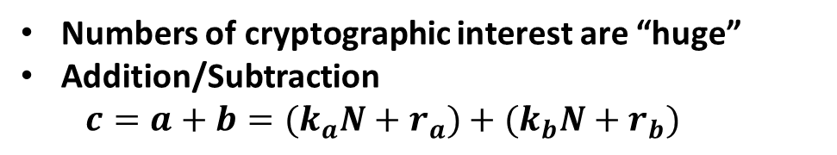
Just do normal math and reduce wherever convenient, but also always at the end
Numbers of cryptographic interest are “huge”
Addition/Subtraction
$$c=a+b={(k}_{a}N+r_{a})+{(k}_{b}N+r_{b})$$
INSERT
VIDEO
HERE

Slide 41
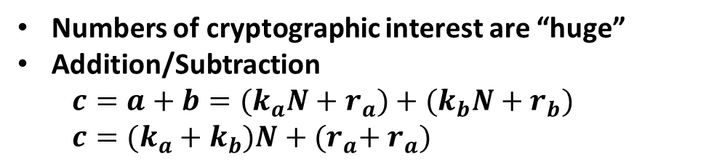
Just do normal math and reduce wherever convenient, but also always at the end
Numbers of cryptographic interest are “huge”
Addition/Subtraction
$$c=a+b={(k}_{a}N+r_{a})+{(k}_{b}N+r_{b})$$
$$c=(k_{a}+k_{b})N+{{(r}_{a}+ r}_{a})$$
INSERT
VIDEO
HERE

Slide 42
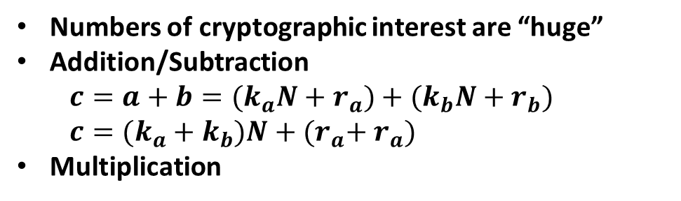
Just do normal math and reduce wherever convenient, but also always at the end
Numbers of cryptographic interest are “huge”
Addition/Subtraction
$$c=a+b={(k}_{a}N+r_{a})+{(k}_{b}N+r_{b})$$
$$c=(k_{a}+k_{b})N+{{(r}_{a}+ r}_{a})$$
Multiplication
INSERT
VIDEO
HERE

Slide 43
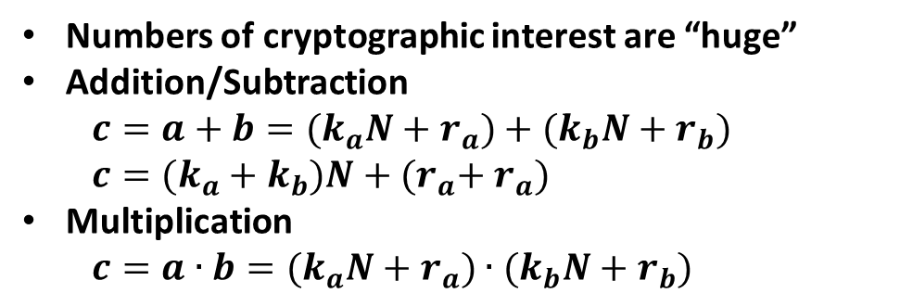
Just do normal math and reduce wherever convenient, but also always at the end
Numbers of cryptographic interest are “huge”
Addition/Subtraction
$$c=a+b={(k}_{a}N+r_{a})+{(k}_{b}N+r_{b})$$
$$c=(k_{a}+k_{b})N+{{(r}_{a}+ r}_{a})$$
Multiplication
$$c=a∙b={(k}_{a}N+r_{a})∙(k_{b}N+r_{b})$$
INSERT
VIDEO
HERE

Slide 44
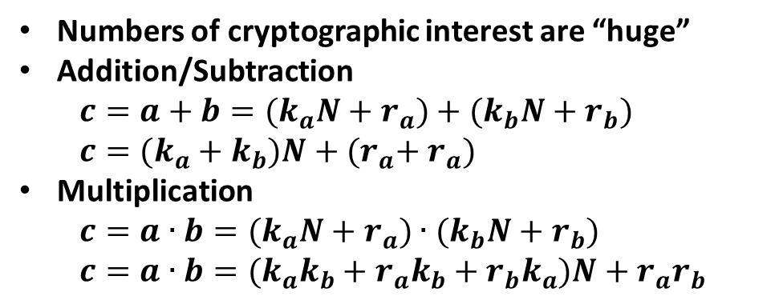
Just do normal math and reduce wherever convenient, but also always at the end
Numbers of cryptographic interest are “huge”
Addition/Subtraction
$$c=a+b={(k}_{a}N+r_{a})+{(k}_{b}N+r_{b})$$
$$c=(k_{a}+k_{b})N+{{(r}_{a}+ r}_{a})$$
Multiplication
$$c=a∙b={(k}_{a}N+r_{a})∙(k_{b}N+r_{b})$$
$$c=a∙b={(k}_{a}k_{b}+r_{a}k_{b}+r_{b}k_{a})N+r_{a}r_{b}$$
INSERT
VIDEO
HERE

Slide 45
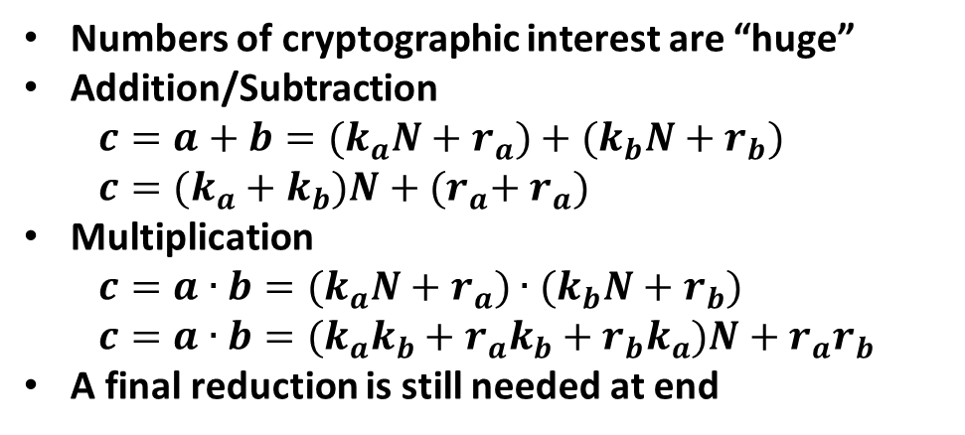
Just do normal math and reduce wherever convenient, but also always at the end
Numbers of cryptographic interest are “huge”
Addition/Subtraction
$$c=a+b={(k}_{a}N+r_{a})+{(k}_{b}N+r_{b})$$
$$c=(k_{a}+k_{b})N+{{(r}_{a}+ r}_{a})$$
Multiplication
$$c=a∙b={(k}_{a}N+r_{a})∙(k_{b}N+r_{b})$$
$$c=a∙b={(k}_{a}k_{b}+r_{a}k_{b}+r_{b}k_{a})N+r_{a}r_{b}$$
A final reduction is still needed at end
INSERT
VIDEO
HERE

Slide 46
Division in a modular world breaks residue class congruency
INSERT
VIDEO
HERE

Slide 47
Division in a modular world breaks residue class congruency
Assume division is defined in modular arithmetic
INSERT
VIDEO
HERE

Slide 48
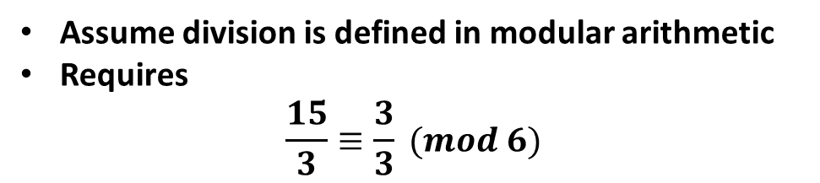
Division in a modular world breaks residue class congruency
Assume division is defined in modular arithmetic
Requires
$$\frac{15}{3}≡\frac{3}{3} (mod 6)$$
INSERT
VIDEO
HERE

Slide 49
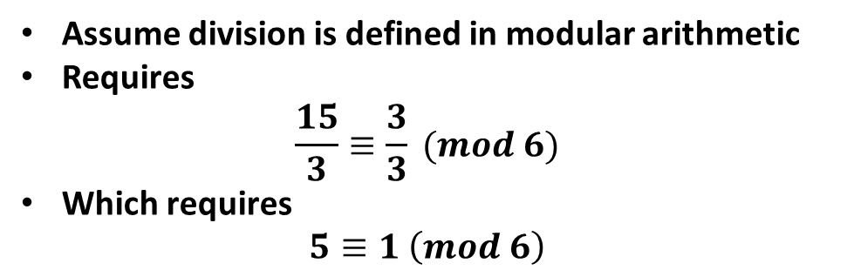
Division in a modular world breaks residue class congruency
Assume division is defined in modular arithmetic
Requires
$$\frac{15}{3}≡\frac{3}{3} (mod 6)$$
Which requires
$$5≡1 \left(mod 6\right)$$
INSERT
VIDEO
HERE

Slide 50
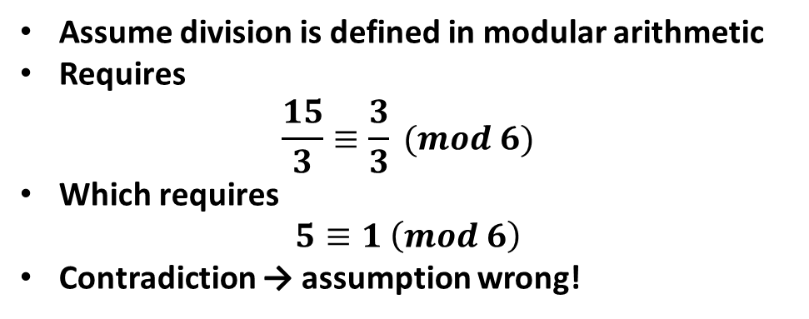
Division in a modular world breaks residue class congruency
Assume division is defined in modular arithmetic
Requires
$$\frac{15}{3}≡\frac{3}{3} (mod 6)$$
Which requires
$$5≡1 \left(mod 6\right)$$
Contradiction → assumption wrong!
INSERT
VIDEO
HERE

Slide 51
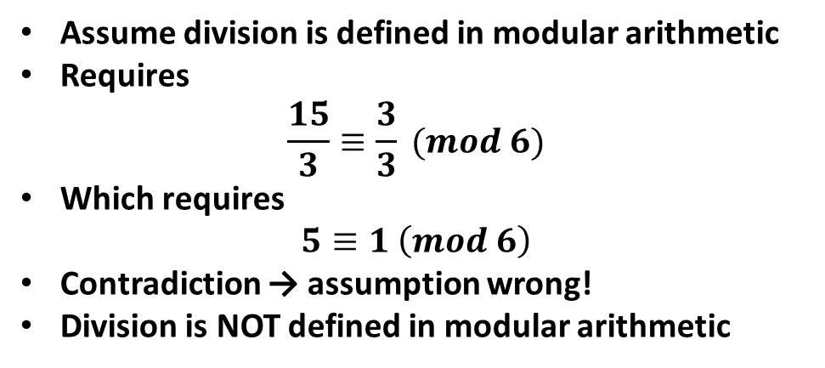
Division in a modular world breaks residue class congruency
Assume division is defined in modular arithmetic
Requires
$$\frac{15}{3}≡\frac{3}{3} (mod 6)$$
Which requires
$$5≡1 \left(mod 6\right)$$
Contradiction → assumption wrong!
Division is NOT defined in modular arithmetic
INSERT
VIDEO
HERE

Slide 52
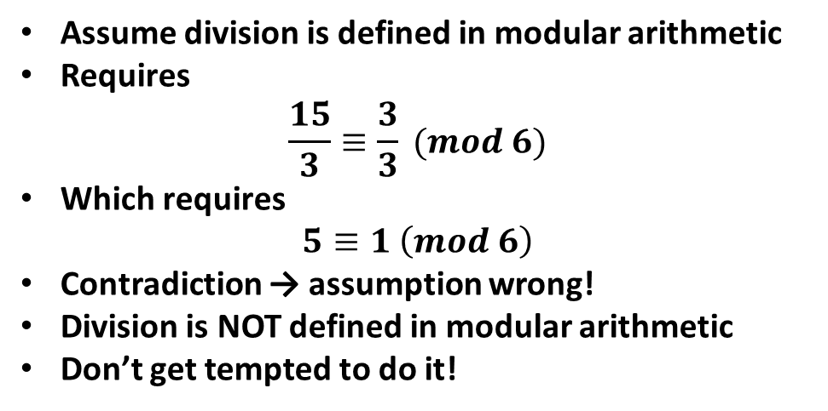
Division in a modular world breaks residue class congruency
Assume division is defined in modular arithmetic
Requires
$$\frac{15}{3}≡\frac{3}{3} (mod 6)$$
Which requires
$$5≡1 \left(mod 6\right)$$
Contradiction → assumption wrong!
Division is NOT defined in modular arithmetic
Don’t get tempted to do it!
INSERT
VIDEO
HERE

Slide 53
Exponentiation is defined, but the exponents live in a different mod world
INSERT
VIDEO
HERE

Slide 54
Exponentiation is defined, but the exponents live in a different mod world
Consider 3¹⁴ mod 7
INSERT
VIDEO
HERE

Slide 55
Exponentiation is defined, but the exponents live in a different mod world
Consider 3¹⁴ mod 7
3¹⁴ mod 7 = 4782969 mod 7 = 2
INSERT
VIDEO
HERE

Slide 56
Exponentiation is defined, but the exponents live in a different mod world
Consider 3¹⁴ mod 7
3¹⁴ mod 7 = 4782969 mod 7 = 2
3^{14 mod 7} mod 7 = 3⁰ mod 7 = 1
INSERT
VIDEO
HERE

Slide 57
Exponentiation is defined, but the exponents live in a different mod world
Consider 3¹⁴ mod 7
3¹⁴ mod 7 = 4782969 mod 7 = 2
3^{14 mod 7} mod 7 = 3⁰ mod 7 = 1
Due to Euler’s Totient Theorem
INSERT
VIDEO
HERE

Slide 58
Exponentiation is defined, but the exponents live in a different mod world
Consider 3¹⁴ mod 7
3¹⁴ mod 7 = 4782969 mod 7 = 2
3^{14 mod 7} mod 7 = 3⁰ mod 7 = 1
Due to Euler’s Totient Theorem
In a mod-7 world, exponents live in mod-6
INSERT
VIDEO
HERE

Slide 59
Exponentiation is defined, but the exponents live in a different mod world
Consider 3¹⁴ mod 7
3¹⁴ mod 7 = 4782969 mod 7 = 2
3^{14 mod 7} mod 7 = 3⁰ mod 7 = 1
Due to Euler’s Totient Theorem
In a mod-7 world, exponents live in mod-6
3^{14 mod 6} mod 7 = 3² mod 7 = 9 mod 7 = 2
INSERT
VIDEO
HERE

Slide 60
Exponentiation is defined, but the exponents live in a different mod world
Consider 3¹⁴ mod 7
3¹⁴ mod 7 = 4782969 mod 7 = 2
3^{14 mod 7} mod 7 = 3⁰ mod 7 = 1
Due to Euler’s Totient Theorem
In a mod-7 world, exponents live in mod-6
3^{14 mod 6} mod 7 = 3² mod 7 = 9 mod 7 = 2
Euler’s Totient Theorem explored in another lesson
INSERT
VIDEO
HERE

Slide 61
Exponentiation is defined, but the exponents live in a different mod world
Consider 3¹⁴ mod 7
3¹⁴ mod 7 = 4782969 mod 7 = 2
3^{14 mod 7} mod 7 = 3⁰ mod 7 = 1
Due to Euler’s Totient Theorem
In a mod-7 world, exponents live in mod-6
3^{14 mod 6} mod 7 = 3² mod 7 = 9 mod 7 = 2
Euler’s Totient Theorem explored in another lesson
This property is critical to modern e-commerce
INSERT
VIDEO
HERE

Slide 62
Sum of digits in n! for n > 5 sheds light on where divisibility rule for 9 comes from
INSERT
VIDEO
HERE

Slide 63
Sum of digits in n! for n > 5 sheds light on where divisibility rule for 9 comes from
Recursively sum up digits until a one-digit result
INSERT
VIDEO
HERE

Slide 64
Sum of digits in n! for n > 5 sheds light on where divisibility rule for 9 comes from
Recursively sum up digits until a one-digit result
6! = 2·3·4·5·6 = 2⁴·3²·5 → 9 | n! (n > 5)
INSERT
VIDEO
HERE

Slide 65
Sum of digits in n! for n > 5 sheds light on where divisibility rule for 9 comes from
Recursively sum up digits until a one-digit result
6! = 2·3·4·5·6 = 2⁴·3²·5 → 9 | n! (n > 5)
If 9 | x, then x mod 9 = 0
INSERT
VIDEO
HERE

Slide 66
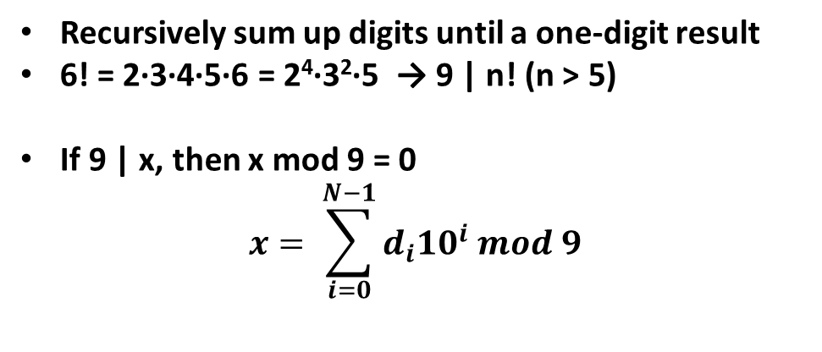
Sum of digits in n! for n > 5 sheds light on where divisibility rule for 9 comes from
Recursively sum up digits until a one-digit result
6! = 2·3·4·5·6 = 2⁴·3²·5 → 9 | n! (n > 5)
If 9 | x, then x mod 9 = 0
$$x= \sum_{i=0}^{N−1}{d_{i}{10}^{i} mod 9}$$
INSERT
VIDEO
HERE

Slide 67
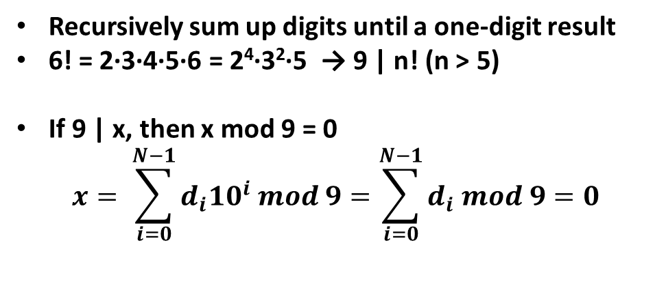
Sum of digits in n! for n > 5 sheds light on where divisibility rule for 9 comes from
Recursively sum up digits until a one-digit result
6! = 2·3·4·5·6 = 2⁴·3²·5 → 9 | n! (n > 5)
If 9 | x, then x mod 9 = 0
$$x= \sum_{i=0}^{N−1}{d_{i}{10}^{i} mod 9=\sum_{i=0}^{N−1}{d_{i} mod 9=0}}$$
INSERT
VIDEO
HERE

Slide 68
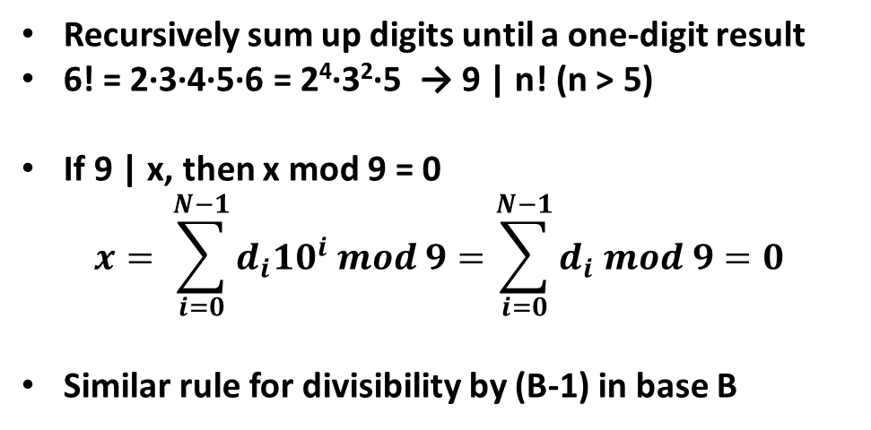
Sum of digits in n! for n > 5 sheds light on where divisibility rule for 9 comes from
Recursively sum up digits until a one-digit result
6! = 2·3·4·5·6 = 2⁴·3²·5 → 9 | n! (n > 5)
If 9 | x, then x mod 9 = 0
$$x= \sum_{i=0}^{N−1}{d_{i}{10}^{i} mod 9=\sum_{i=0}^{N−1}{d_{i} mod 9=0}}$$
Similar rule for divisibility by (B-1) in base B
INSERT
VIDEO
HERE

Slide 69
Modular arithmetic provides for a generic divisibility rule that is efficient
INSERT
VIDEO
HERE

Slide 70
Modular arithmetic provides for a generic divisibility rule that is efficient
x = 5432 = ( ( (0 + 5)·10 + 4 )·10 + 3 )·10 + 2
INSERT
VIDEO
HERE

Slide 71
Modular arithmetic provides for a generic divisibility rule that is efficient
x = 5432 = ( ( (0 + 5)·10 + 4 )·10 + 3 )·10 + 2
Can perform mod reductions as desired.
INSERT
VIDEO
HERE

Slide 72
Modular arithmetic provides for a generic divisibility rule that is efficient
x = 5432 = ( ( (0 + 5)·10 + 4 )·10 + 3 )·10 + 2
Can perform mod reductions as desired.
If divisor ≤ base, reduce digits and base first
INSERT
VIDEO
HERE

Slide 73
Modular arithmetic provides for a generic divisibility rule that is efficient
x = 5432 = ( ( (0 + 5)·10 + 4 )·10 + 3 )·10 + 2
Can perform mod reductions as desired.
If divisor ≤ base, reduce digits and base first
Powerful general algorithm
INSERT
VIDEO
HERE

Slide 74
Modular arithmetic provides for a generic divisibility rule that is efficient
x = 5432 = ( ( (0 + 5)·10 + 4 )·10 + 3 )·10 + 2
Can perform mod reductions as desired.
If divisor ≤ base, reduce digits and base first
Powerful general algorithm
Easily implemented in a program
INSERT
VIDEO
HERE

Slide 75
Modular arithmetic provides for a generic divisibility rule that is efficient
x = 5432 = ( ( (0 + 5)·10 + 4 )·10 + 3 )·10 + 2
Can perform mod reductions as desired.
If divisor ≤ base, reduce digits and base first
Powerful general algorithm
Easily implemented in a program
Space efficient: Largest sum < base·divisor
INSERT
VIDEO
HERE

Slide 76
Modular arithmetic provides for a generic divisibility rule that is efficient
x = 5432 = ( ( (0 + 5)·10 + 4 )·10 + 3 )·10 + 2
Can perform mod reductions as desired.
If divisor ≤ base, reduce digits and base first
Powerful general algorithm
Easily implemented in a program
Space efficient: Largest sum < base·divisor
Time efficient: O(log(v))
INSERT
VIDEO
HERE

Slide 77
Modular arithmetic provides for a generic divisibility rule that is efficient
x = 5432 = ( ( (0 + 5)·10 + 4 )·10 + 3 )·10 + 2
Can perform mod reductions as desired.
If divisor ≤ base, reduce digits and base first
Powerful general algorithm
Easily implemented in a program
Space efficient: Largest sum < base·divisor
Time efficient: O(log(v))
Base/divisor-specific algorithms can be faster
INSERT
VIDEO
HERE

Slide 78
In review…
INSERT
VIDEO
HERE

Slide 79
In review…
Defining relationship for modular arithmetic
INSERT
VIDEO
HERE

Slide 80
In review…
Defining relationship for modular arithmetic
Residue/congruence classes
INSERT
VIDEO
HERE

Slide 81
In review…
Defining relationship for modular arithmetic
Residue/congruence classes
Modular congruence vs. modular reduction
INSERT
VIDEO
HERE

Slide 82
In review…
Defining relationship for modular arithmetic
Residue/congruence classes
Modular congruence vs. modular reduction
Add, subtract, multiply good; divide bad
INSERT
VIDEO
HERE

Slide 83
In review…
Defining relationship for modular arithmetic
Residue/congruence classes
Modular congruence vs. modular reduction
Add, subtract, multiply good; divide bad
Exponents live in a different modular world
INSERT
VIDEO
HERE

Slide 84
In review…
Defining relationship for modular arithmetic
Residue/congruence classes
Modular congruence vs. modular reduction
Add, subtract, multiply good; divide bad
Exponents live in a different modular world
Generic divisibility algorithm
INSERT
VIDEO
HERE

Slide 85
In review…
Defining relationship for modular arithmetic
Residue/congruence classes
Modular congruence vs. modular reduction
Add, subtract, multiply good; divide bad
Exponents live in a different modular world
Generic divisibility algorithm
Coming up
INSERT
VIDEO
HERE

Slide 86
In review…
Defining relationship for modular arithmetic
Residue/congruence classes
Modular congruence vs. modular reduction
Add, subtract, multiply good; divide bad
Exponents live in a different modular world
Generic divisibility algorithm
Coming up
Multiplicative inverses and how to find them
INSERT
VIDEO
HERE

Slide 87
In review…
Defining relationship for modular arithmetic
Residue/congruence classes
Modular congruence vs. modular reduction
Add, subtract, multiply good; divide bad
Exponents live in a different modular world
Generic divisibility algorithm
Coming up
Multiplicative inverses and how to find them
Modular exponentiation
INSERT
VIDEO
HERE

